Slide 1
REACT JS

Slide 2
Prerequisite
HTML
CSS
JS - filter ,map , reduce functions
Basic Understanding of ES 6 - ECMAScript 6 - ECMAScript was created to standardize JavaScript

Slide 3
What is React ?
React is an open source javascript library for buiding user interface
This is project created in 2011 by facebook
It is not a framework
It Focus on building rich UI

Slide 4
Why learn React ?
Component based Architecture
Break down complex application into the small parts
Every react application has at least one components that is known as a root components.
Reusable code
component that can created in React can be reuse in angular or vue.

Slide 5
Why learn React ?
React is declarative
Tell react what you want and react library build that actual UI.
React handle efficiently updating and rendering of UI components.
seamlessly integrate react into any of your application
Portion of page or complete page or even entire application

Slide 6
Setting up enviroment
From Extention panel install prettier – code formatter
Open File -> Preferences -> settings -> TextEditor -> Formatting -> Format on save (check)
In Search bar write Formmater -> select Formatter
To change color theme Workbench -> Appearance

Slide 7
Create React App
npx
npx create-react-app <project_name>
npm start
npm
npm install create-react-app -g
Create-react-app <project_name>

Slide 8
Create React App
Development Server
Web Pack
Bable
https://babeljs.io/repl

Slide 9
Folder structure
node_modules - It contains all third party library and react itself.
public – It contains public assets of application
src – It contains basic component that is app component.

Slide 10
Component based architecture
Components describe a part of the user interface.
They are re-usable and can be nested inside other components.
Components usually placed in a javascript file.
For example App components placed in a app.js file.

Slide 11
Component
A piece of UI

Slide 13
Every react application has at-least one Root component that is a App Component. It represent the entire application. Root component contain other child component.
APP

Slide 14
Component based architecture
Stateless functional component
JavaScript function - return HTML that describes UI.
function welcome(props)
{
return <h1>Hello</h1>;
}
Stateful class component
Class extends component class. It contain render() method that return HTML
class Welcome extends React.Components
{
render()
{
return <h1>Hello</h1>;
}
}

Slide 15
Functional components
Functional components are just javascript function.
It accept Property object as a input and return HTML
Properties
(props)
JavaScript Function
HTML(JSX)

Slide 16
Functional components
1) Create a folder components in src.
2) create a new file Hello.js inside component folder.
3) import and call component from app.js
import React from 'react‘
function Greet()
{
return <h1> Hello </h1>;
} export default greet
import Greet from './component/Hello';
function App() {
return (
<div className="App">
<Greet></Greet>
</div>
);
}

Slide 17
Functional components
Normal Function
import React from 'react‘
function greet()
{
return <h1> Hello </h1>;
} export default greet
Arrow Function
import React from 'react‘
const Greet = () => <h1>Welcome</h1>
export default greet

Slide 18
Functional components
Import Components
import Greet from './component/Hello'; → Here import name is same as function name
import MyComponent from './component/Hello'; → You can assign any name to the import component.
Export Component
export const Greet = () => <h1>Welcome</h1>

Slide 19
Class components
Properties
(props)
ES 6 Class
HTML(JSX)
State

Slide 20
Class components
1) Create a folder components in src.
2) create a new file Welcome.js inside component folder.
import React from "react";
import { Component } from "react";
class Welcome extends Component{
render()
{
return <h1>Welcome to rect</h1>;
}
}
export default Welcome

Slide 21
Function vs class component
Functional
Class
Simple function
Use Function component as much as possible
Absence of ‘this’ keyword
Solution without using state’
Mainly responsible for UI
Stateless
More feature rich
Maintain their own private data – state
Complex UI logic
Stateful

Slide 22
JSX
JavaScript XML – Extension to the javascript language syntax
Write XML – like code for elements and components
JSX have a tag name , attribute and children
JSX is not necessary to write react application.
JSX makes your react code simpler and elegent.

Slide 23
JSX
import React from "react";
const Hello = () => { return(
<div>
<h1>Hello JSX</h1>
</div>
)
}
export default Hello
import React, { createElement } from "react";
const Hello = () => {
return React.createElement
('div',{'id':'msg',className:'dummy'},
React.createElement('h1',null,'Hello JSX'));
}
export default Hello

Slide 24
Props
Components are reusable part of the react. All type of components, takes props as a optional argument. It also allow components to be dynamic.
Props are immutable means we cannot change its value.
Props with functional components.
For functional components we need to
pass props as a arguments.
const Test = (Props) => {
// console.log(Props); return (
<div>
<h1> Hello {Props.name}. It is {Props.type} language </h1>
{Props.children}
</div>
)
}
<Test name="React" type="Front-end">
<p> Child Paragraph Tag </p>
</Test>

Slide 25
Props
Props with class components
For class components props are available by default using this keyword.
class Welcome extends React.Component
{
render()
{
return(
<div> <h1>Hello class {this.props.name}</h1> </div>
)
}
}
<Welcome name="Programming"/>

Slide 26
structuring state and props
const Test = ({name,type}) => {
//const {name,type} = props
return (
<div>
<h1>Hello {name} {type} Progamming Language </h1>
</div>
)
}

Slide 27
State
Props
State
Props gets Passed to the component
Function Parameter
Props are immutable
props – functional components
this.props – class component
State is managed within component
Variables are declared within function body
State can be changes
useState Hook – functional components
This.state – class component

Slide 28
State - setstate
Syntax:
setState(updater[, callback])
The first argument is an updater function with the signature:
(prevState, props) => stateChange
prevState is a reference to the previous state. It should not be directly mutated.
The second parameter to setState() is an optional callback function that will be executed once setState is completed and the component is re-rendered

Slide 29
State
class Message extends React.Component{
constructor(){
super(){
this.state = {
msg : 'Welcome visitor'
}
}
}
display(){
this.setState({
msg : "Thank you for subscription"
})
}
render()
{
return(
<div>
<h1>{this.state.msg} </h1>
<button onClick={() => this.display()}>Subscribe</button>
</div>
)
}
}
export default Message

Slide 30
State – callback function
constructor(props) {
super(props)
this.state = {
count:0
}
}
increment(){
this.setState(
{
count : this.state.count + 1
},() => {console.log(this.state.count)})
//console.log(this.state.count)
}
render() {
return (
<div>
<h1>
{this.state.count} <br/>
<button onClick={() => this.increment()}>Click to increment</button>
</h1>
</div>
);
}

Slide 31
State - prevstate
prevState
increment(){ this.setState((prevState) => ({ count : prevState.count + 1
}))
// console.log(this.state.count)
}
increment5() {
this.increment()
this.increment()
this.increment()
this.increment()
this.increment()
}
When you have to update state based on previous state value, pass in function as an argument instead of the regular object.
prevState is a name that you have given to the argument passed to setState.
What it holds is the value of state before the setState was triggered by React;
Since setState does batching, its sometimes important to know what the previous state was when you want to update the new state based on the previous state value.

Slide 32
EVENT handling
Handling events with React elements is very similar to handling events on DOM elements. There are some syntax differences:
React events are named using camelCase, rather than lowercase.
With JSX you pass a function as the event handler, rather than a string.
HTML
<button onclick="activateLasers()"> Activate Lasers
</button>
REACT
<button onClick={activateLasers}> Activate Lasers
</button>

Slide 33
EVENT handling
If you have used JavaScript before then you are familiar with the ‘this’ keyword and how it works.
If you don’t bind the ‘this’ keyword with the event handler then it will point to undefined in the callback.
This is JavaScript-specific behavior and is not related to React. There are four different ways to bind ‘this’ keyword to the event handler.

Slide 34
EVENT handling
1. BINDING INSIDE THE CONSTRUCTOR:
this.clickHandler = this.clickHandler.bind(this)
2. BINDING BY PASSING ARROW FUNCTION INSIDE THE EVENT LISTENER:
<button onClick={() => this.clickHandler()}>CLICK</button>
3. BINDING DIRECTLY WHEN PASSING THE FUNCTION:
<button onClick={this.clickHandler.bind(this)}>CLICK</button>
4. BINDING WITH THE HELP OF ARROW FUNCTION:
clickHandler = () => { this.setState({ message : "GoodBye“})}

Slide 35
EVENT handling
class ClassClick extends Component { constructor(props) {
super(props)
this.state = { message : "Hello“ } // this.clickHandler = this.clickHandler.bind(this)
} // clickHandler() { // this.setState({
// message : "GoodBye"
// }) // console.log("Butotn Click")
// } clickHandler = () => { this.setState({
message : "GoodBye" })}
render() {
return (
<div>
{this.state.message} <br/>
<button onClick={this.clickHandler.bind(this)}> CLICK ME</button>
<button onClick={() => this.clickHandler()}> CLICK ME</button>
<button onClick={this.clickHandler}>
CLICK ME</button>
</div>
)
}
}
export default ClassClick

Slide 36
CALL MULTIPLE FUNCTIONS INSIDE AN ONCLICK EVENT HANDLER
We can call multiple functions inside the onClick event handler in React. To do so we just need to call them one by one.
printMsg(){
console.log("Message")
}
showAert(){
alert("Alert Box");
}
clickHandler(){
this.printMsg()
this.showAert()
}

Slide 37
PASSING ARGUMENT TO EVENT HANDLERS
Sometimes we need to pass an extra parameter to the event handler. We can do that using two of the methods above.
Example:
Pass the event and an extra parameter, like id, in the event listener using the arrow function.
<button onClick={(e) => this.deleteRow(id, e)}>Delete Row</button>
Or we can use them by directly binding them when passing the event handler in the event listener and passing an extra parameter there.
<button onClick={this.deleteRow.bind(this, id)}>Delete Row</button>

Slide 38
Method as props
import React from 'react'
function ChildComponent(props) {
return (
<div>
<button onClick={props.greetHandler}> Greet parent
</button>
</div>
)
} export default ChildComponent
class ParentComponent extends Component { constructor(props) {
super(props) this.state = {
parentname: "Parent"
} this.greetParent = this.greetParent.bind(this) } greetParent() {
alert(`hello ${this.state.parentname}`)
} render() {
return ( <div> <ChildComponent greetHandler={this.greetParent}></ChildComponent> </div> )
} }

Slide 39
Conditional rendering
1. if-else statement
2. Element variable
3. Ternary conditional operator
4. Short circuit operator

Slide 40
Conditional rendering
import React, { Component } from 'react' class Conditional extends Component {
constructor(props) {
super(props)
this.state = {
isLoggedIn : true
}
}
render() { return ( <div>
<div>Welcome Kruti</div>
<div>Welcome Visitor</div>
</div>)
}
} export default Conditional

Slide 41
Conditional rendering
If-else statement
render() {
if(this.state.isLoggedIn)
{
return (<div>Welcome Kruti</div>)
}
else
{
return (<div>Welcome Visitor</div>)
}
}
Element Variable
render() { let Message
if(this.state.isLoggedIn) {
Message = <div>Welcome Kruti</div>
}
else{
Message = <div>Welcome Visitor</div>
} return(<div>{Message}</div>)
}

Slide 42
Conditional rendering
Ternary operator
render() {
return(
this.state.isLoggedIn ?
<div>Welcome Kruti</div> :
<div>Welcome visitor</div>
) }
Short circuit operator
render() { return this.state.isLoggedIn && <div>Welcome Kruti</div>
}

Slide 43
LIST RENDERING
Lists are very useful when it comes to developing the UI of any website. Lists are mainly used for displaying menus in a website, for example, the navbar menu. In regular JavaScript, we can use arrays for creating lists. We can create lists in React in a similar manner as we do in regular JavaScript.
We can use the map() function in JavaScript for traversing the lists.

Slide 44
List rendering
When you run this code, you’ll be given a warning that a key should be provided for list items. A “key” is a special string attribute you need to include when creating lists of elements.
Keys help React identify which items have changed, are added, or are removed. Keys should be given to the elements inside the array to give the elements a stable identity:
function NameList()
{
const names = ["Mahesh","Paresh","Suresh"]
const namelist = names.map(n => <h2>{n}</h2>)
return <div>{namelist}</div>
}

Slide 45
Styling react component
1. CSS stylesheets – className attribute
2. Inline styling – style attribute
3. CSS module
4. CSS in JS library (styled components)

Slide 46
Styling react component
CSS Stylesheet
------------------------------------
import React from 'react'
import './myStyles.css'
function StyleSheet() {
return (
<div className='primary'>StyleSheet</div>
)
}
export default StyleSheet
CSS Stylesheet - conditional
------------------------------------
import React from 'react'
import './myStyles.css'
function StyleSheet(props) { const cname = props.primary ? 'primary' : '' return (
<div className={cname}>StyleSheet</div>
)
}
export default StyleSheet

Slide 47
Styling react component
CSS Stylesheet – Multiple Class
------------------------------------
import React from 'react'
import './myStyles.css'
function StyleSheet(props) { const cname = props.primary ? 'primary' : '' return (
<div className={`${cname} font-xl`}>StyleSheet</div>
)
} export default StyleSheet
Inline CSS
-------------------------
import React from 'react' const heading = {
color:'yellow',
fontSize : '50px'
} export default function Inline() {
return (
<div style={heading}>Inline</div>
)
}

Slide 48
Styling react component
CSS Module
------------------------------------
import './appStyle.css';
import style from './appStyle.module.css'
<h1 className='error'>Error</h1>
<h1 className={style.success}>Success</h1>

Slide 49
Controlled components
In a controlled component, form data is handled by a React component. It takes its current value through props and makes changes through callbacks like onClick, onChange, etc.
The alternative is uncontrolled components, where form data is handled by the DOM itself.

Slide 50
Controlled components
this.state={
email:’’
}
this.changeEmailHandler = (event) => {
this.setState({email:event.target.value}) }
<input type=“text” value= {this.state.email} onChange={this.changeEmailHandler} />

Slide 51
Life Cycle Method
Life Cycle method for class components:
Mounting
When instance of component created and inserted into the DOM.
Updating
When component is re-render as a result of changes to either its props or state
Unmounting
When component is being removed from DOM.
Error Handling
When there is a error during rendering, in a life cycle method or in a constructor

Slide 52
Life Cycle Method
Life Cycle method for class components:
Mounting
constructor static getDerivedStateFromProps, render and componentDidMount
Updating
static getDerivedStateFromProps, shouldComponentUpdate, render
getSnapshotBeforeUpdate and componentDidUpdate
Unmounting
componentWillUnmount
Error Handling
static getDerivedStateFromError and componentDidCatch

Slide 53
Mounting lifecycle method
Constructor
A Special function that will get called whenever a new component is created.
Initializing state
Binding the event handler
super(props) – after this only we can access this.props in a constructor
Directly overwrite the this.state

Slide 54
Mounting lifecycle method
constructor
When a state of the components depend on changes in props over time.
Static getDerivedStateFromProps(props,state)
When initial state of the components depend on the props passed to the
Components in such scenario to setState this method is used.
This method is a static method so does not have access to the this keyword.
So you cannot call this.setState from this method. Return object that
represent new state of the components.

Slide 55
Mounting lifecycle method
constructor
It is a required method in a class component.
Static getDerivedStateFromProps(props,state)
It reads props and state and return JSX that describe UI.
render()
Do not change state or interact with DOM or make ajax calls.
Children component life cycle methods are also executed

Slide 56
Mounting lifecycle method
constructor
It is called only once. Invoked immediately after a component and all its
children components have been rendered to the DOM.
Static getDerivedStateFromProps(props,state)
You can Interact with DOM or perform any ajax call inside this method.
render()
componentDidMount()

Slide 57
updating lifecycle method
Static getDerivedStateFromProps(props,state)
Method is called every time a component is rendered.
Set the state
Cannot make HTTP request from this method

Slide 58
updating lifecycle method
Static getDerivedStateFromProps(props,state)
Dictates if the component should re-render or not.
shouldComponentUpdate(nextProps,nextState)
Performance optimization
Cannot make HTTP request or setState from this method

Slide 59
updating lifecycle method
Static getDerivedStateFromProps(props,state)
Only required method
shouldComponentUpdate(nextProps,nextState)
Read props and state and return JSX
render()
Do not change state or interact with DOM or make ajax calls.

Slide 60
updating lifecycle method
Static getDerivedStateFromProps(props,state)
Called right before the changes from virtual DOM are to be reflected in DOM
shouldComponentUpdate(nextProps,nextState)
Capture some information from the DOM
render()
Method will either return null or return a value. Returned value will be passed as the third parameter to the next method.
getSnapshotBeforeUpdate(prevProps,prevState)

Slide 61
updating lifecycle method
Static getDerivedStateFromProps(props,state)
Called after the render is finished in the re-render cycles
shouldComponentUpdate(nextProps,nextState)
This method called only at once during life cycle.
render()
getSnapshotBeforeUpdate(prevProps,prevState)
componentDidUpdate(prevProps,prevState,snapshot)

Slide 62
Unmounting phase method
componentWillUnmount()
Method is invoked immediately before a component is unmounted and destroyed.
Cancelling any network request, removing event handler, cancelling any subscription and also invalidating timers.
Do not call setState method

Slide 63
Error handling phase method
Static getDerivedStateFromError(error)
When there is an error either during rendering, in a life cycle method or in the constructor of any child component.
componentDidCatch(error,info)

Slide 64
React fragment
A common pattern in React is for a component to return multiple elements. Fragments let you group a list of children without adding extra nodes to the DOM
render() {
return (
<React.Fragment>
<ChildA />
<ChildB />
<ChildC />
</React.Fragment>
);
}

Slide 65
React fragment
A common pattern is for a component to return a list of children. Take this example React snippet:
class Table extends Component {
render() {
return (
<table>
<tr>
<Columns />
</tr>
</table>
);
}
}
class Columns extends Component {
render() {
return (
<div>
<td>Hello</td>
<td>World</td>
</div>
);
}
}
<table>
<tr>
<div>
<td>Hello</td>
<td>World</td>
</div>
</tr>
</table>

Slide 66
React fragment
Fragments solve this problem.
class Table extends Component {
render() {
return (
<table>
<tr>
<Columns />
</tr>
</table>
);
}
}
class Columns extends Component {
render() {
return (
<React.Fragment>
<td>Hello</td>
<td>World</td>
</React.Fragment>
);
}
}
<table>
<tr>
<td>Hello</td>
<td>World</td>
</tr>
</table>

Slide 67
React fragment
here is a new, shorter syntax you can use for declaring fragments. It looks like empty tags. You can use <></> the same way you’d use any other element except that it doesn’t support keys or attributes.
class Table extends Component {
render() {
return (
<table>
<tr>
<Columns />
</tr>
</table>
);
}
}
class Columns extends Component {
render() {
return (
<>
<td>Hello</td>
<td>World</td>
</>
);
}
}
<table>
<tr>
<td>Hello</td>
<td>World</td>
</tr>
</table>

Slide 68
React fragment
Fragments declared with the explicit <React.Fragment> syntax may have keys. A use case for this is mapping a collection to an array of fragments — for example, to create a description list.
function Glossary(props) {
return (
<dl>
{props.items.map(item => (
<React.Fragment key={item.id}>
<dt>{item.term}</dt>
<dd>{item.description}</dd>
</React.Fragment>
))}
</dl>
); }

Slide 69
Pure component
React.PureComponent is similar to React.Component. The difference between them is that React.Component doesn’t implement shouldComponentUpdate(), but React.PureComponent implements it with a shallow prop and state comparison.
SC of prevState with currentState
SC of preProps with currentProps
If your React component’s render() function renders the same result given the same props and state, you can use React.PureComponent for a performance boost in some cases.
Difference ?
Re-render Component

Slide 70
Shallow comparision (SC)
Primitive Types – Number , String , Boolean
A SC B returns true if a and b have the same value and are of the same types
Ex: string ‘Promise’ (SC) string ‘Promise’ returns true
Complex Types – Array , Object
A SC B returns true if a and b reference the exact same object
var a = [1,2,3];
var b = [1,2,3];
var c = a;
var a_b = (a===b); // false
Var a_c = (a===c); // true
var a = {x:1 , y:2};
var b = {x:1 , y:2};
var c = a;
var a_b = (a===b); // false
Var a_c = (a===c); // true

Slide 71
memo
React.memo is a higher order component.
If your component renders the same result given the same props, you can wrap it in a call to React.memo for a performance boost in some cases by memoizing the result. This means that React will skip rendering the component, and reuse the last rendered result.
This method only exists as a performance optimization. Do not rely on it to “prevent” a render, as this can lead to bugs.

Slide 72
MEMO
Unlike the shouldComponentUpdate() method on class components, the areEqual function returns true if the props are equal and false if the props are not equal.
function MyComponent(props) {
/* render using props */
}
function areEqual(prevProps, nextProps) {
}
export default React.memo(MyComponent, areEqual);

Slide 73
MEMO
import React from "react";
function MemoDemo({ name }) {
console.log("Memo Component render");
return <div>MemoDemo {name}</div>;
}
export default React.memo(MemoDemo);

Slide 74
refs
Refs provide a way to access DOM nodes or React elements created in the render method.
When to Use Refs
There are a few good use cases for refs:
Managing focus, text selection, or media playback.
Triggering imperative animations.
Integrating with third-party DOM libraries.

Slide 75
Creating and accessing refs
Refs are created using React.createRef() and attached to React elements via the ref attribute.
When a ref is passed to an element in render, a reference to the node becomes accessible at the current attribute of the ref.
class MyComponent extends React.Component {
constructor(props) {
super(props);
this.myRef = React.createRef();
}
render() {
return <div ref={this.myRef} />;
}
}
const node = this.myRef.current;

Slide 76
Ref with Class Component
class Demo1 extends Component {
constructor(props) {
super(props);
this.inputref = React.createRef();
}
focusInput() {
this.inputref.current.focus();
}
render() {
return (<div>
Enter Name : <input type="text" ref={this.inputref} />
</div>);
}
}
export default Demo1;
import Demo1 from "../Demo1";
class ParentDemo extends Component {
constructor(props) {
super(props);
this.comRef = React.createRef();
}
clickHandler = () => {
this.comRef.current.focusInput();
};
render() {
return (<div>
<Demo1 ref={this.comRef} /> <br />
<button type="submit" onClick={this.clickHandler}>
CLICK</button>
</div>);
}
}

Slide 77
Forwarding ref
Ref forwarding is a technique for automatically passing a ref through a component to one of its children. This is typically not necessary for most components in the application. However, it can be useful for some kinds of components, especially in reusable component libraries.
Here is a step-by-step explanation of what happens in the above example:
1) We create a React ref by calling React.createRef and assign it to a ref variable.
2) We pass our ref down to <Demo1 ref={this.comRef} /> by specifying it as a JSX attribute.
3) React passes the ref to the (props, ref) => ... function inside forwardRef as a second argument.
4) We forward this ref argument down to <input type="text" ref={ref} /> by specifying it as a JSX attribute.
5) When the ref is attached, ref.current will point to the <input> DOM node.

Slide 78
Forwarding ref
import Demo1 from "../Demo1"; class ParentDemo extends Component {
constructor(props) {
super(props);
this.comRef = React.createRef();
} clickHandler = () => {
this.comRef.current.focus();
}; render() {
return (
<div>
<Demo1 ref={this.comRef} /> <br />
<button type="submit" onClick={this.clickHandler}>
CLICK </button>
</div>
); } }
import React from "react";
const Demo1 = React.forwardRef((props, ref) => {
return (
<div>
<input type="text" ref={ref} />
</div>
);
});
export default Demo1;

Slide 79
portal
Portals provide a first-class way to render children into a DOM node that exists outside the DOM hierarchy of the parent component.
ReactDOM.createPortal(child, container)
The first argument (child) is any renderable React child, such as an element, string, or fragment. The second argument (container) is a DOM element.
References: https://codesandbox.io/s/00254q4n6p
Event Public: https://codepen.io/gaearon/pen/jGBWpE

Slide 80
portal
import React from "react";
import ReactDOM from "react-dom";
function PortalDemo() {
return ReactDOM.createPortal(
<h1>PortalDemo</h1>,
document.getElementById("portal-root")
);
}
export default PortalDemo;

Slide 81
ERROR boundaries
Error boundaries are React components that catch JavaScript errors anywhere in their child component tree, log those errors, and display a fallback UI instead of the component tree that crashed. Error boundaries catch errors during rendering, in lifecycle methods, and in constructors of the whole tree below them.
Error boundaries do not catch errors for:
Event handlers
Asynchronous code (e.g. setTimeout or requestAnimationFrame callbacks)
Server side rendering
Errors thrown in the error boundary itself (rather than its children)

Slide 82
ERROR boundaries
Use static getDerivedStateFromError() to render a fallback UI after an error has been thrown. Use componentDidCatch() to log error information.

Slide 83
Higher order components
A higher-order component (HOC) is an advanced technique in React for reusing component logic. HOCs are not part of the React API, per se. They are a pattern that emerges from React’s compositional nature.
Concretely, a higher-order component is a function that takes a component and returns a new component.
const EnhancedComponent = higherOrderComponent(OriginalComponent);

Slide 84
Higher order components
import React, { Component } from "react";
const UpdatedComponent = (OriginalComponent) => {
class NewComponent extends Component { render() {
return (
<OriginalComponent />
);
}
}
return NewComponent;
};
export default UpdatedComponent;

Slide 85
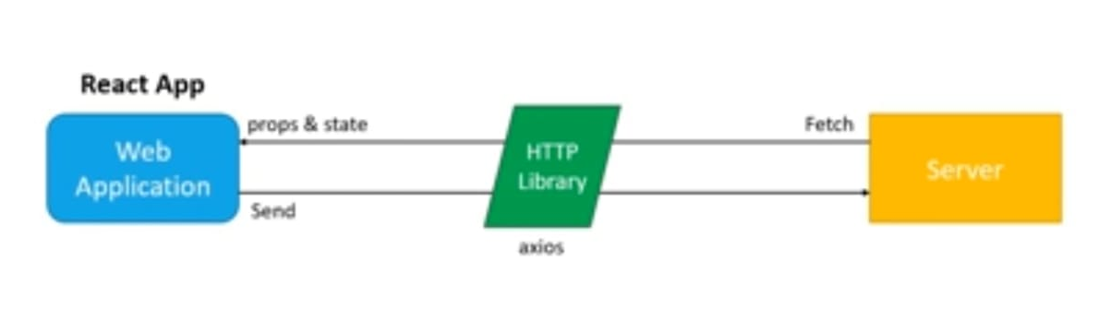
React and http

Slide 86
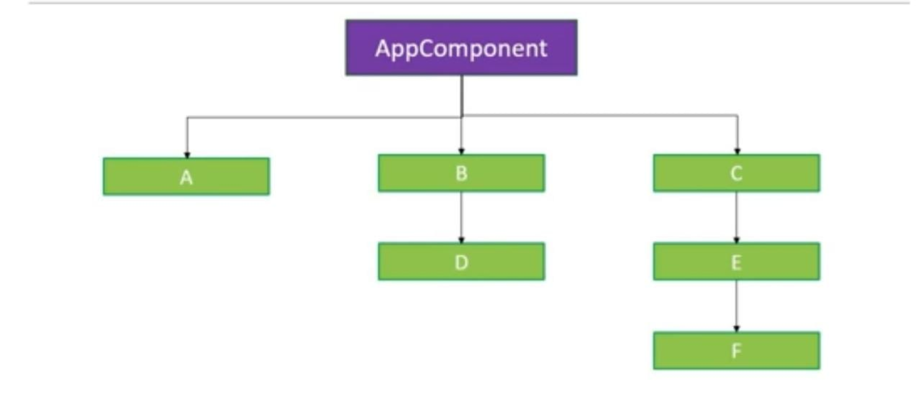
context

Slide 87
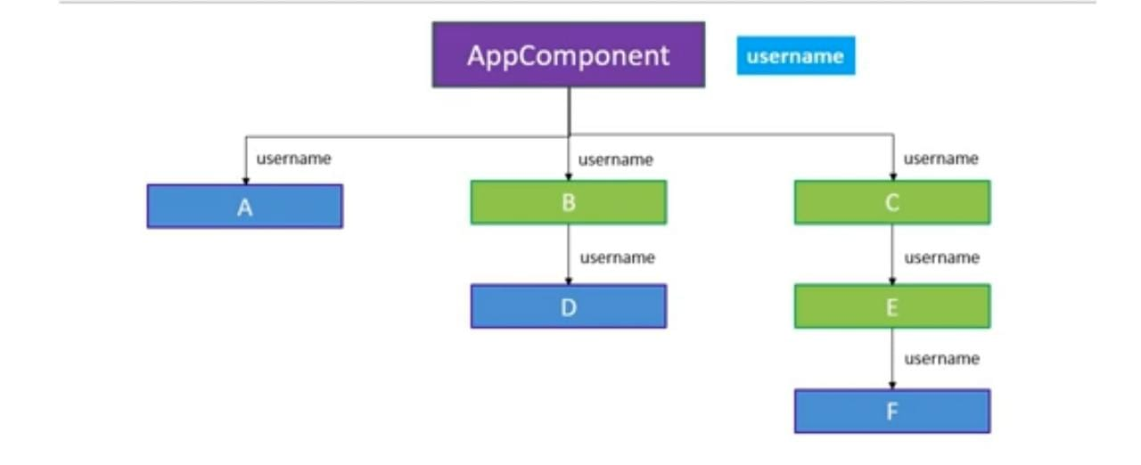
context

Slide 88
context
Context provides a way to pass data through the component tree without having to pass props down manually at every level.
Context is designed to share data that can be considered “global” for a tree of React components, such as the current authenticated user, theme, or preferred language.

Slide 89
context
1) create the context
2) Provide context value
3) Consume the context value

